Slide 1
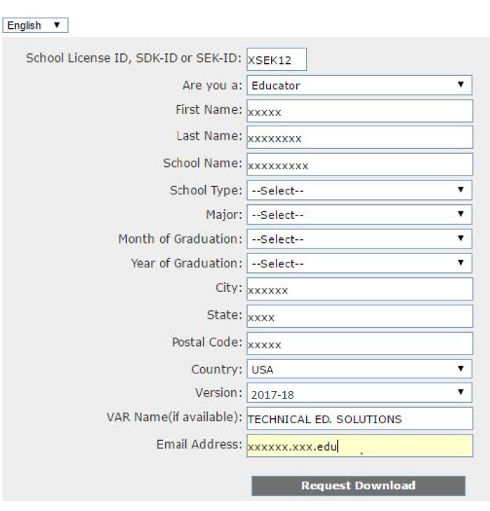
SOLIDWORKS 2017
Installation of the “Student Engineering Kit” (SEK) is available via download:
http://www.SolidWorks.com/SEK using the SEK-ID: XSEK12
SolidWorks Student Access Activation Code: 9020006745104445B745HM97
Copyright 2017

